Slide 1
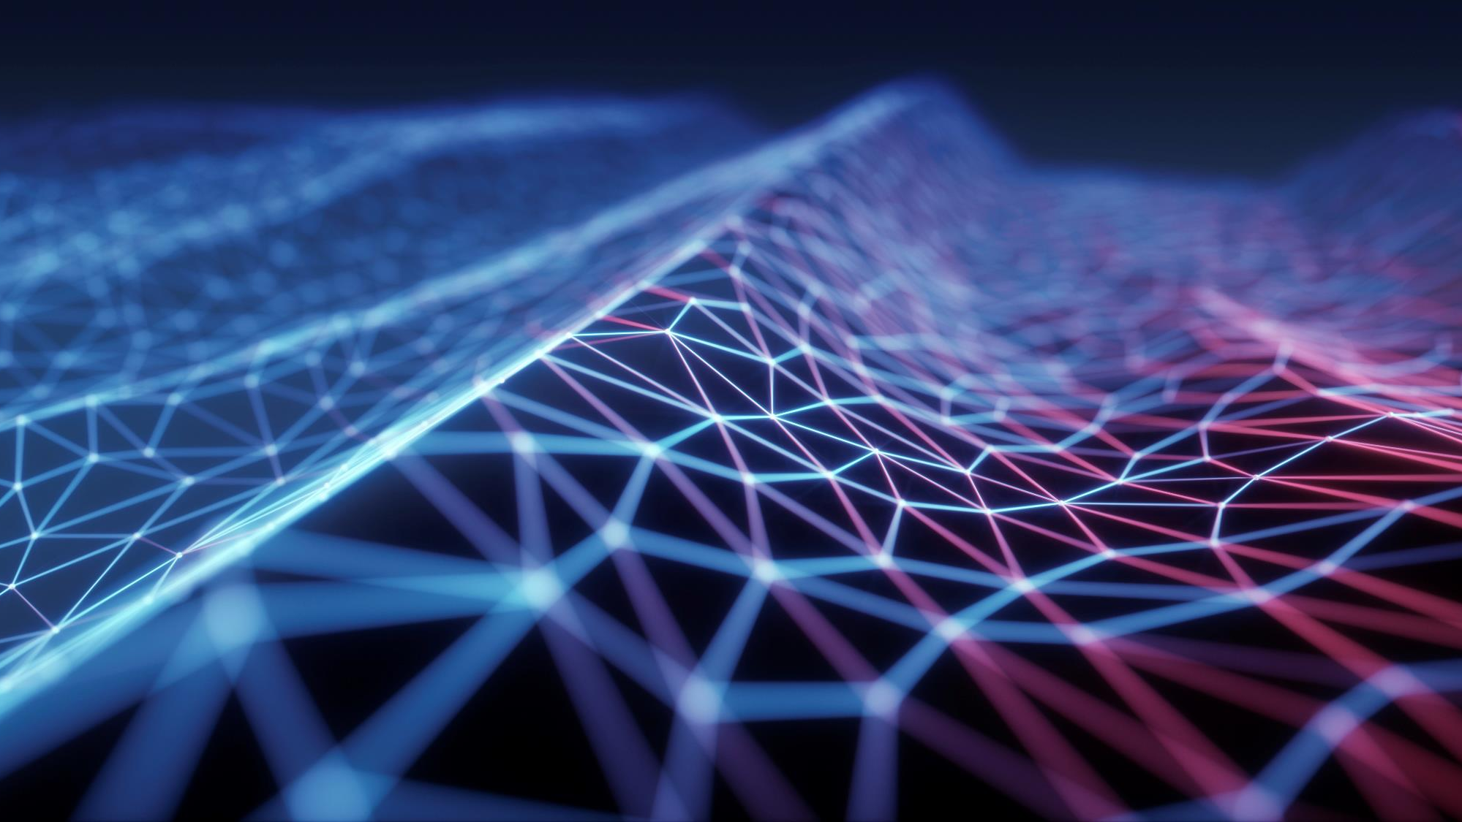
Screen Time Analysis

Slide 2
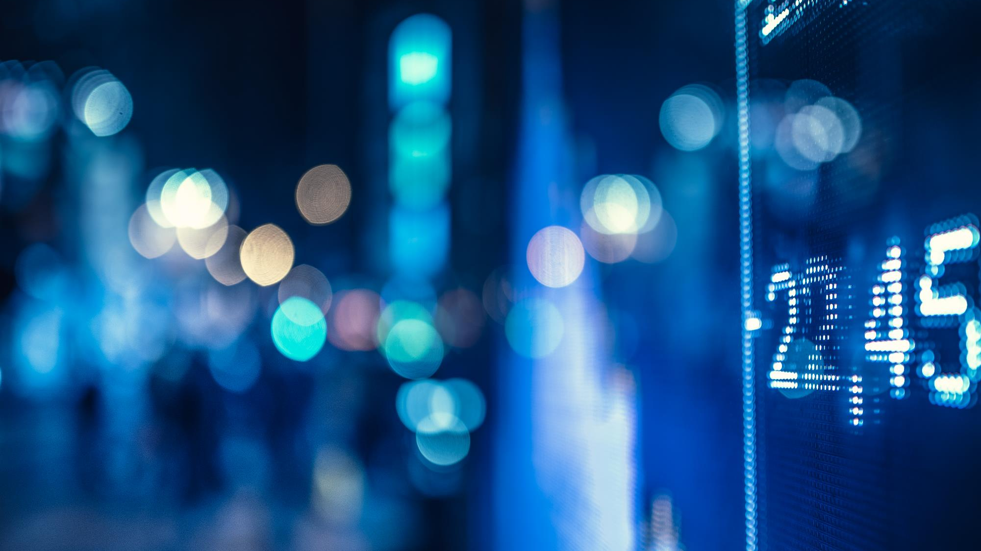
CONTENT
Introduction
Data Collection and Preprocessing
Machine learning Algorithms
Conclusion

Slide 3
Introduction
The problem of screen time analysis using machine learning is concerned with predicting the amount of time a person spends on screen-based devices such as smartphones, tablets, computers, and TVs. The excessive use of these devices has been linked to various negative health effects such as eye strain, sleep disturbances, and obesity. Moreover, the rise of remote work and virtual communication has increased the use of these devices, making it even more important to monitor and manage screen time. By developing machine learning models to predict screen time, we can gain insights into the factors that contribute to excessive screen use and develop strategies to help individuals manage their screen time more effectively.

Slide 4

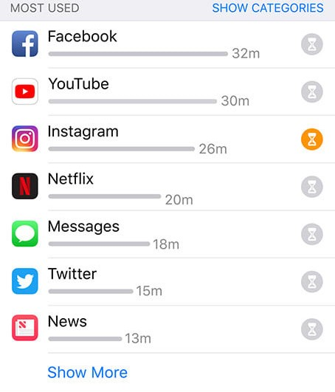
Analyzing the screen time of a user helps smartphone companies give a review of all the activities of the user on their smartphone. It helps users understand if they were productive, creative, or wasted their time

Slide 5
Importing libraries
WE HAVE USED MOST POPULAR LIBRARIES SUCH AS:
PANDAS
NUMPY
MATPLOTLIB
SCIKIT-LEARN

Slide 6
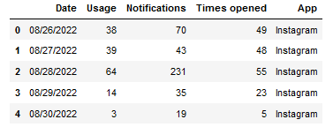
READING DATA:
WE USED EXISTING DATASET FOR ANALYSIS:

Slide 7
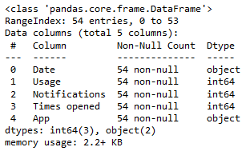
Data cleaning
Date: Date of the record
Usage: Number of times the user used the smartphone in a day
Notifications: Number of notifications the user received in a day
Times opened: Number of times the app was opened by the user
App: The app that was opened by the user

Slide 8
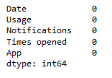
finding if the dataset has any null values or not:

Slide 9
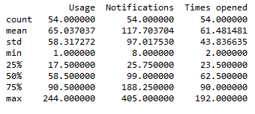
descriptive statistics of the data:

Slide 10
Data visualization
Data visualization is an important part of screen time analysis as it helps in understanding patterns and trends in the data. It can also help in identifying outliers and anomalies in the data.
We have used plot graph and bar graph for the dataset.

Slide 11
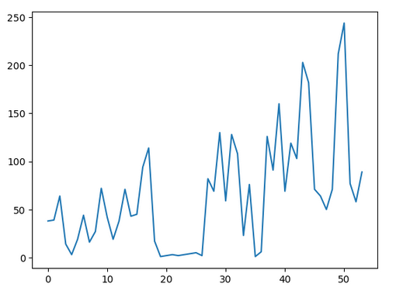
Line graph shows the Usage of Screen time :

Slide 12
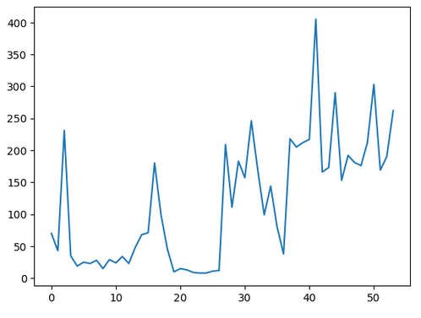
Line graph shows the Notification of Screen time :

Slide 13
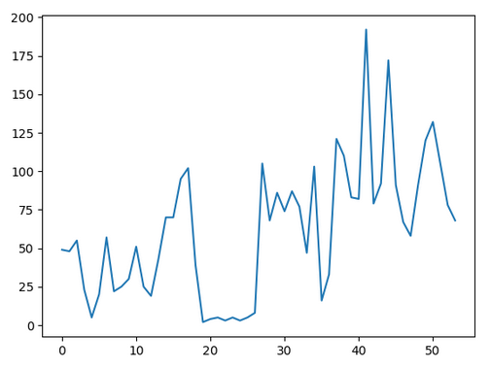
Line graph shows the Times opened of Screen time :

Slide 14
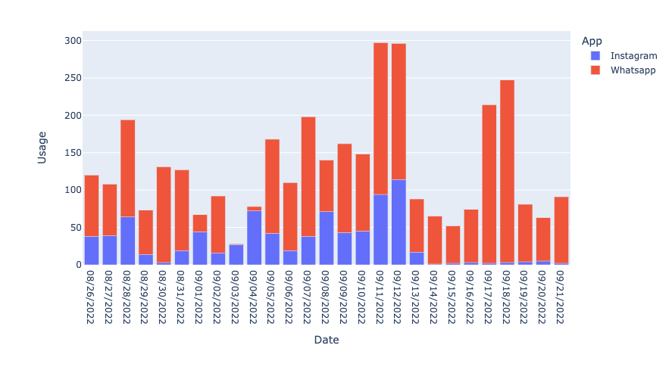
Bar graph shows the amount of usage of the apps :

Slide 15
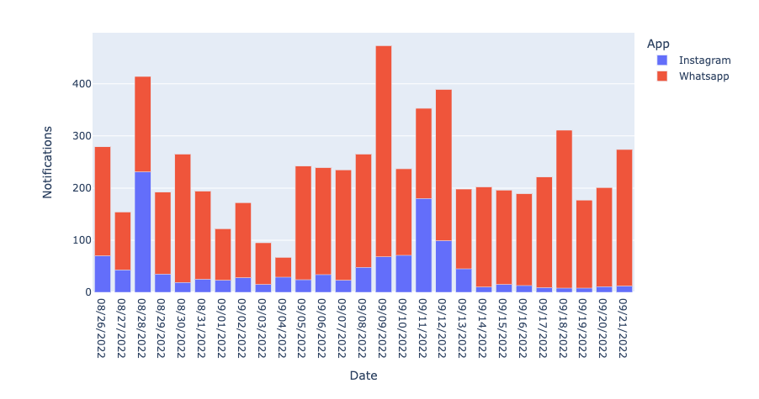
Bar graph shows the number of Notifications the apps :

Slide 16
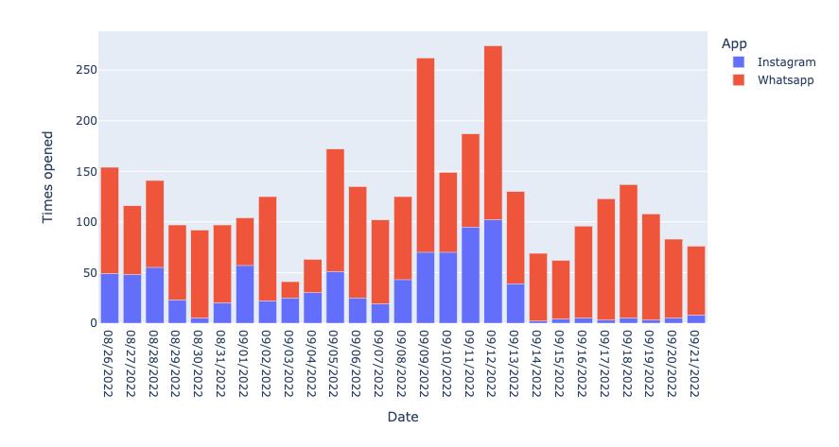
Bar graph shows the number of times the apps opened:

Slide 17
Finding algorithm using Machine learning
In the context of screen time analysis, supervised learning techniques can be used for tasks such as predicting screen time based on various factors, while unsupervised learning can be used to identify patterns in screen time behavior. Reinforcement learning can be used to develop personalized interventions to reduce excessive screen time.

Slide 18
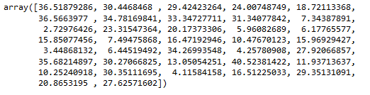
Linear regression
Linear regression is one of the easiest and most popular Machine Learning algorithms. It is a statistical method that is used for predictive analysis. its shows a linear relationship between a dependent (y) and one or more independent (y) variables, hence called as linear regression. Since linear regression shows the linear relationship, which means it finds how the value of the dependent variable is changing according to the value of the independent variable.

Slide 19
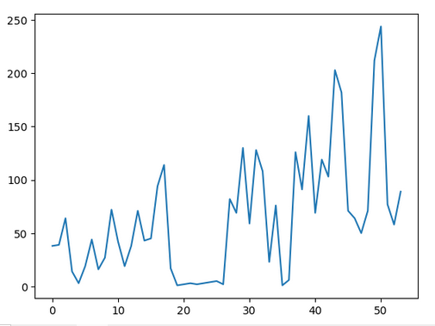
GRAPHS SHOWS THE LINEAR REGRESSION DATASET

Slide 20
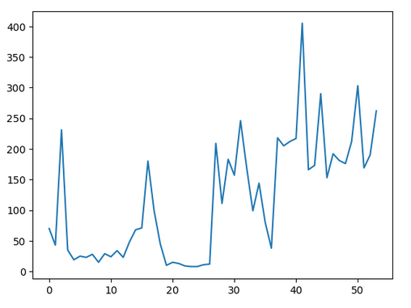
GRAPHS SHOWS THE LINEAR PREDICTION DATASET

Slide 21
Polynomial regression
Polynomial Regression is a regression algorithm that models the relationship between a dependent(y) and independent variable(x) as nth degree polynomial.
This is the polynomial prediction for the screen timing

Slide 22
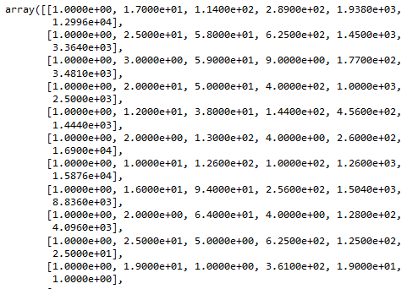

Slide 23

Regression TREE
Decision Tree is a supervised learning algorithm which can be used for solving both classification and regression problems. It can solve problems for both categorical and numerical data

Slide 24
Exploratory data analysis
Exploratory data analysis (EDA) is used by data scientists to analyze and investigate data sets and summarize their main characteristics, often employing data visualization methods. It helps determine how best to manipulate data sources to get the answers you need, making it easier for data scientists to discover patterns, spot anomalies, test a hypothesis, or check assumptions.

Slide 25
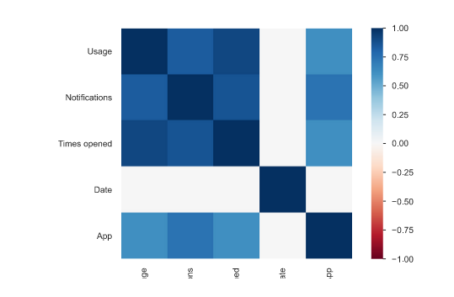
HEAT MAP:

Slide 26
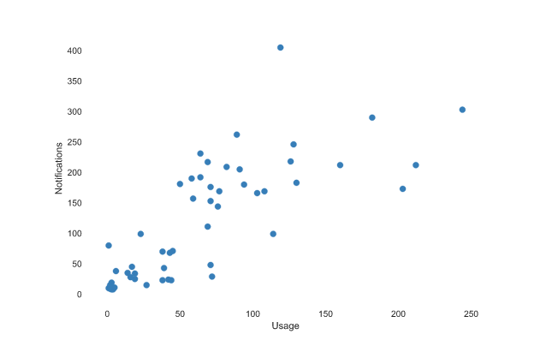
Interactions:
INTERATIONS OF USAGE AND NOTIFICATIONS

Slide 27
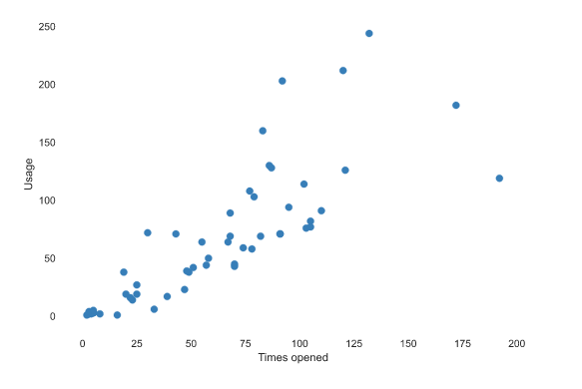
INTERATIONS OF USAGE AND TIMES OPENED:

Slide 28
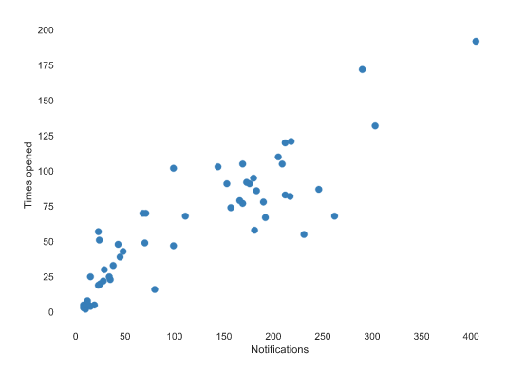
INTERATIONS OF TIMES OPENED AND NOTIFICATIONS:

Slide 29
conclusion
The conclusion of the screen time analysis using machine learning presentation would summarize the key points of the presentation and provide a clear call to action. Summary of the key findings and insights gained from the analysis Discussion of the potential impact of these findings on individuals, families, or society as a whole. The conclusion should be concise and clear, leaving the audience with a clear understanding of the main takeaways and a sense of urgency to take action

Slide 30
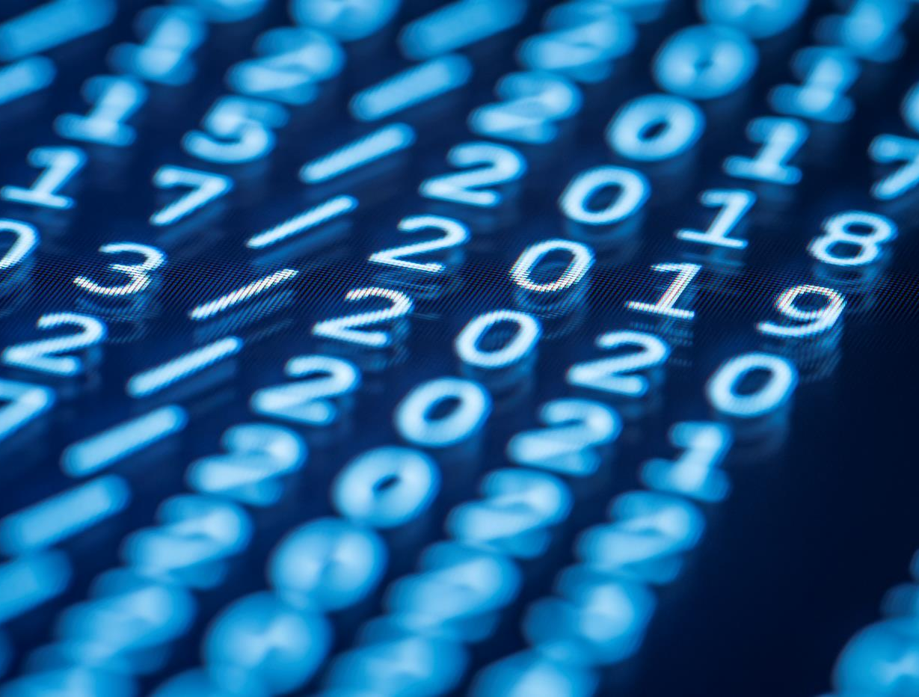
Thank You

